Slide 1
Choosing a Database

Slide 2
Background
There are a lot of different options for databases, and each of them has a unique implementation! How can we decide which to choose for our systems design interview?

Slide 3
Review: Indexes
A database index is used for the purpose of speeding up reads conditioned on the value of a specific key! Be careful to not overuse indexes, as they slow down database writes.
Two main types:
LSM Trees + SSTables
B-Trees

Slide 4
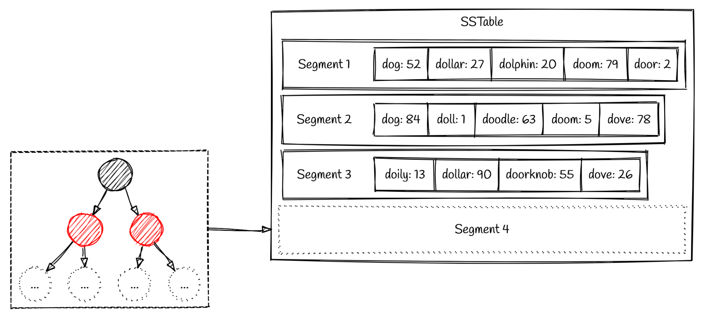
Review: LSM Trees and SSTables
Writes first go to a balanced binary search tree in memory
Tree flushed to a sorted table on disk when it gets too big
Can binary search SSTables for the value of a key
If there are too many SSTables they can be merged together (old values of keys will be discarded)
Pro: Fast writes to memory!
Con: May have to search many SSTables for value of key.

Slide 5
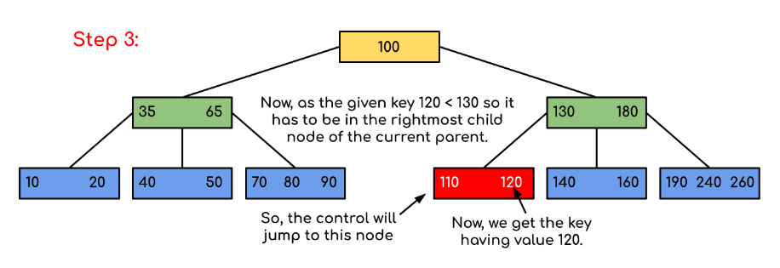
Review: B-Trees
A binary tree using pointers on disk
Writes iterate through the binary tree and either overwrite the existing key value or create a new page on disk and modify the parent pointer to the new page
Pro: Faster reads, know exactly where key is located!
Con: Slow writes to disk instead of memory.

Slide 6
Review: Replication
Replication is the process of having multiple copies of data in order to make sure that if a database goes down the data isn’t lost!
Types:
Single leader replication
All writes go to one database, reads come from any database
Multi leader replication
Writes can go to a small subset of leader databases reads can come from any database
Leaderless replication
Writes go to all databases, reads come from all databases

Slide 7
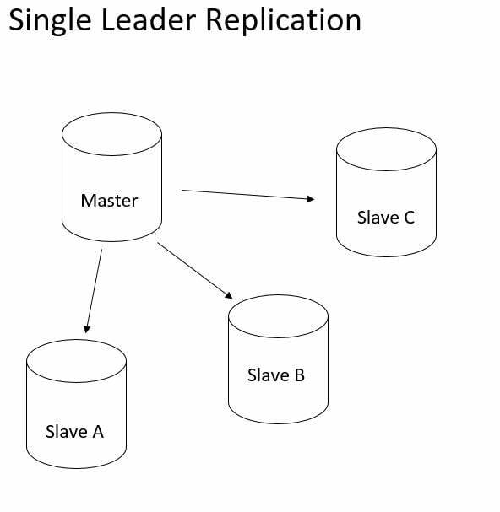
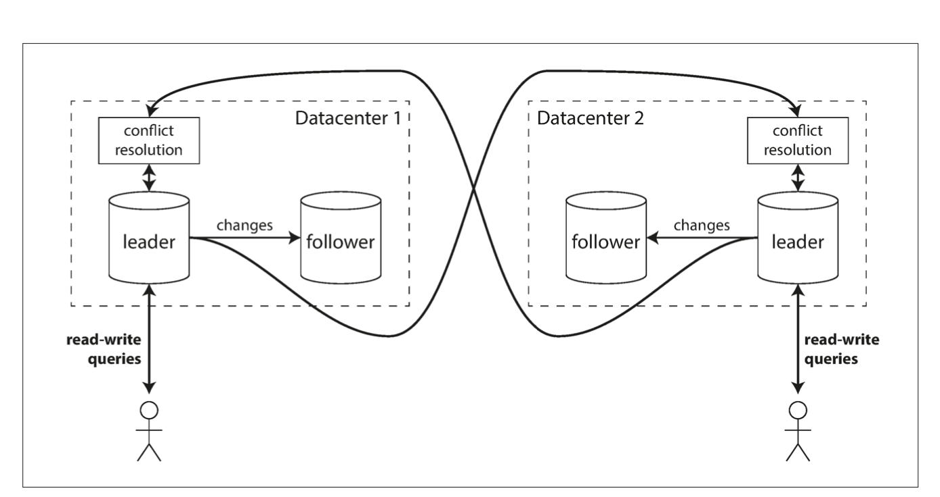
Review: Replication Continued
Single leader replication is useful to ensure that there are no data conflicts, all writes will go to one node
Leaderless and multileader replication is useful for increasing write throughput beyond just one database node (at the cost of potential write conflicts)

Slide 8
Let’s Get Started!

Slide 9
SQL Databases
Key Features:
Relational/Normalized data - changes to one table may require changes to others
E.g. adding an author and their books to different tables on different nodes
May require two phase commit! (Expensive)
Have transactional (ACID guarantees)
Excessively slow if you don’t need them (due to two phase locking)
Typically use B-trees
Better for reads than writes in theory
Conclusion: Use SQL when correctness is of more importance than speed
See banking applications, job scheduling

Slide 10
MongoDb
Key Features:
Document data model (NoSQL)
Data is written in large nested documents, better data locality (if you choose to organize your data in a way that takes advantage of this) - but denormalized
B-Trees and Transactions supported
Conclusion: Rarely makes sense to use in a systems design interview since nothing is “special” about it, but good if you want SQL like guarantees on data with more flexibility via the document model

Slide 11
Apache Cassandra
Key Features:
Wide column data store (NoSQL), has a shard key and a sort key
Allows for flexible schemas, ease of partitioning
Multileader/Leaderless replication (configurable)
Super fast writes, albeit uses last write wins for conflict resolution
May clobber existing writes if they were not the winner of LWW
Index based off of LSM tree and SSTables
Fast writes
Conclusion: Great for applications with high write volume, consistency is not as important, all writes and reads go to the same shard (no transactions)
See chat application for a good example of when to use

Slide 12
Riak
Key Features:
Wide column data store (NoSQL), has a shard key and a sort key
Allows for flexible schemas, ease of partitioning
Multileader/Leaderless replication (configurable)
Super fast writes, supports CRDTs (conflict free replicated data types)
Allows for implementing things like counters and sets in a conflict free way, custom code to handle conflicts
Index based off of LSM tree and SSTables
Fast writes
Conclusion: Great for applications with high write volume, consistency is not as important, all writes and reads go to the same shard (no transactions)
See chat application for a good example of when to use

Slide 13
Apache HBase
Key Features:
Wide column data store (NoSQL), has a shard key and a sort key
Allows for flexible schemas, ease of partitioning
Single leader replication
Built on top of hadoop, ensures data consistency and durability
Slower than leaderless replication
Index based off of LSM tree and SSTables
Fast writes
Column oriented storage
Column compression and increased data locality within columns of data
Conclusion: Great for applications that need fast column reads
Multiple thumbnails of a youtube video, sensor readings

Slide 14
Memcached and Redis
Key Features:
Key value stores implemented in memory (Redis a bit more feature rich)
Uses a hashmap under the hood
Conclusion: Useful for data that needs to be written and retrieved extremely quickly, memory is expensive so good for small datasets
Good for caches, certain essential app features (see geo spatial index for Lyft)

Slide 15
Neo4j
Key Features:
Graph database!
As opposed to just using a SQL database under the hood with relations to represent nodes and edges, actually has pointers from one address on disk to another for quicker lookups
The former is bad because reads become slower proportional to the size of the index (O log n to binary search), but using direct pointers is O(1)
Conclusion: Only useful for data naturally represented in graph formats
Map data, friends on social media

Slide 16
TimeScaleDB/Apache Druid
Key Features:
Time series database!
Use LSM trees for fast ingestion, but break table into many small indexes by both ingestion source and timestamp
Allows for placing the whole index in CPU cache for better performance, quick deletes of whole index when no longer relevant (as opposed to typical tombstone method)
Conclusion: Very niche but serve their purpose very well
Great for sensor data, metrics, logs, where you want to read by the ingestor and range of timestamp

Slide 17
New SQL
VoltDb
SQL but completely in memory, single threaded execution for no locking
Expensive and only allows for small datasets
Spanner
SQL, uses GPS clocks in data center to avoid locking by using timestamps to determine order of writes
Very expensive
Cool discussions to have in an interview, but probably pretty impractical to ever actually suggest!

